Slide 1

ADVERTISING
By: Brianna Bricken, Alexandra Cashin, Rejane Chandler, Cedric Denis, Daniel Driggers and Valerie Mius

Slide 2
For Women in Advertising, It’s Still a ‘Mad Men’ World

Slide 3
Introduction
Advertising is producing adverts to promote commercial products or services.
Advertising is market targeted and is designed to influence a specific market segment.
Gender stereotypes have taken root in advertising.
Some adverts promote gender bias unintentionally.
Radio advertising involves audio adverts only.
Notes:
Advertising is the activity of producing adverts to promote a certain product or service in the market. It is a form of product promotion that uses audio or visual content geared towards influencing the market to purchase a product. Some adverts promote gender stereotypes that advance biasness against women and sometimes even violence. Radio advertising is adverts that are only recorded as audio and may promote gender bias through the language.

Slide 4

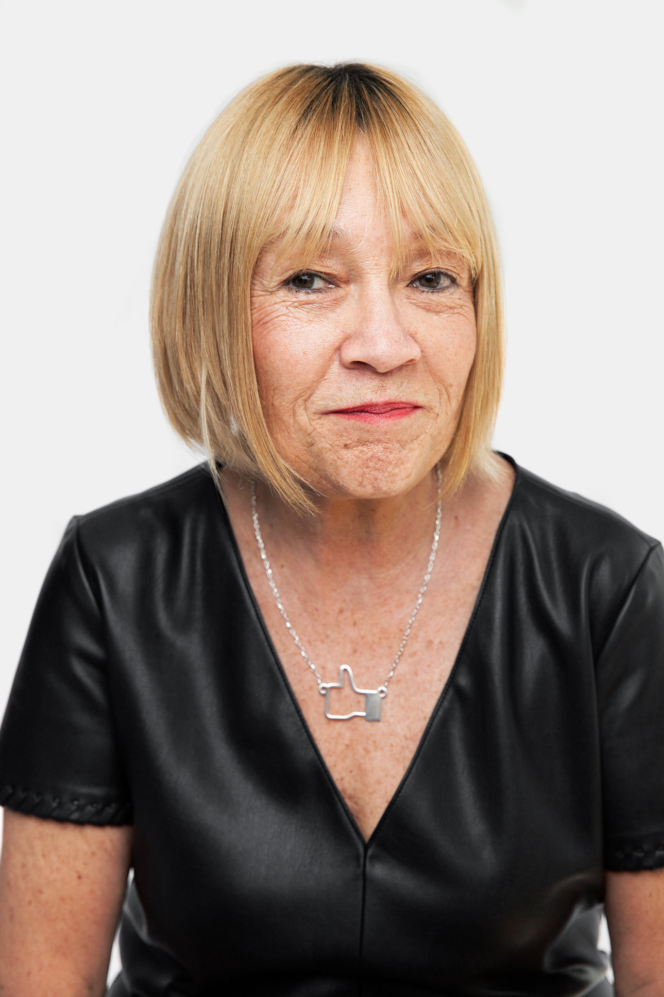
Cindy Gallop
Former advertising executive
“At the top of the industry is a closed loop of white guys talking to other white guys.”

Slide 5
Gender stereotyping in radio advertising
Terms used show that women's role is in the kitchen and not the professional world.
Women only do adverts for kitchen wares.
Gender displays in adverts are more explicit on women (Nixon, 2003).
Feminism has been promoted using advertising.
Notes:
The concern of how adverts are being produced has been raised due to its insensitivity towards women's issues. Adverts promote a culture of gender stereotyping through its display and language use. The language used towards women is to depict them as dependents or subjects of the male gender. Adverts will be designed to show that women's role is only in the kitchen when women do all adverts involving kitchenware while men do other professional commercials. There are explicit depicture of women on the billboards in various adverts, indicating the gender gap in advertising.

Slide 6
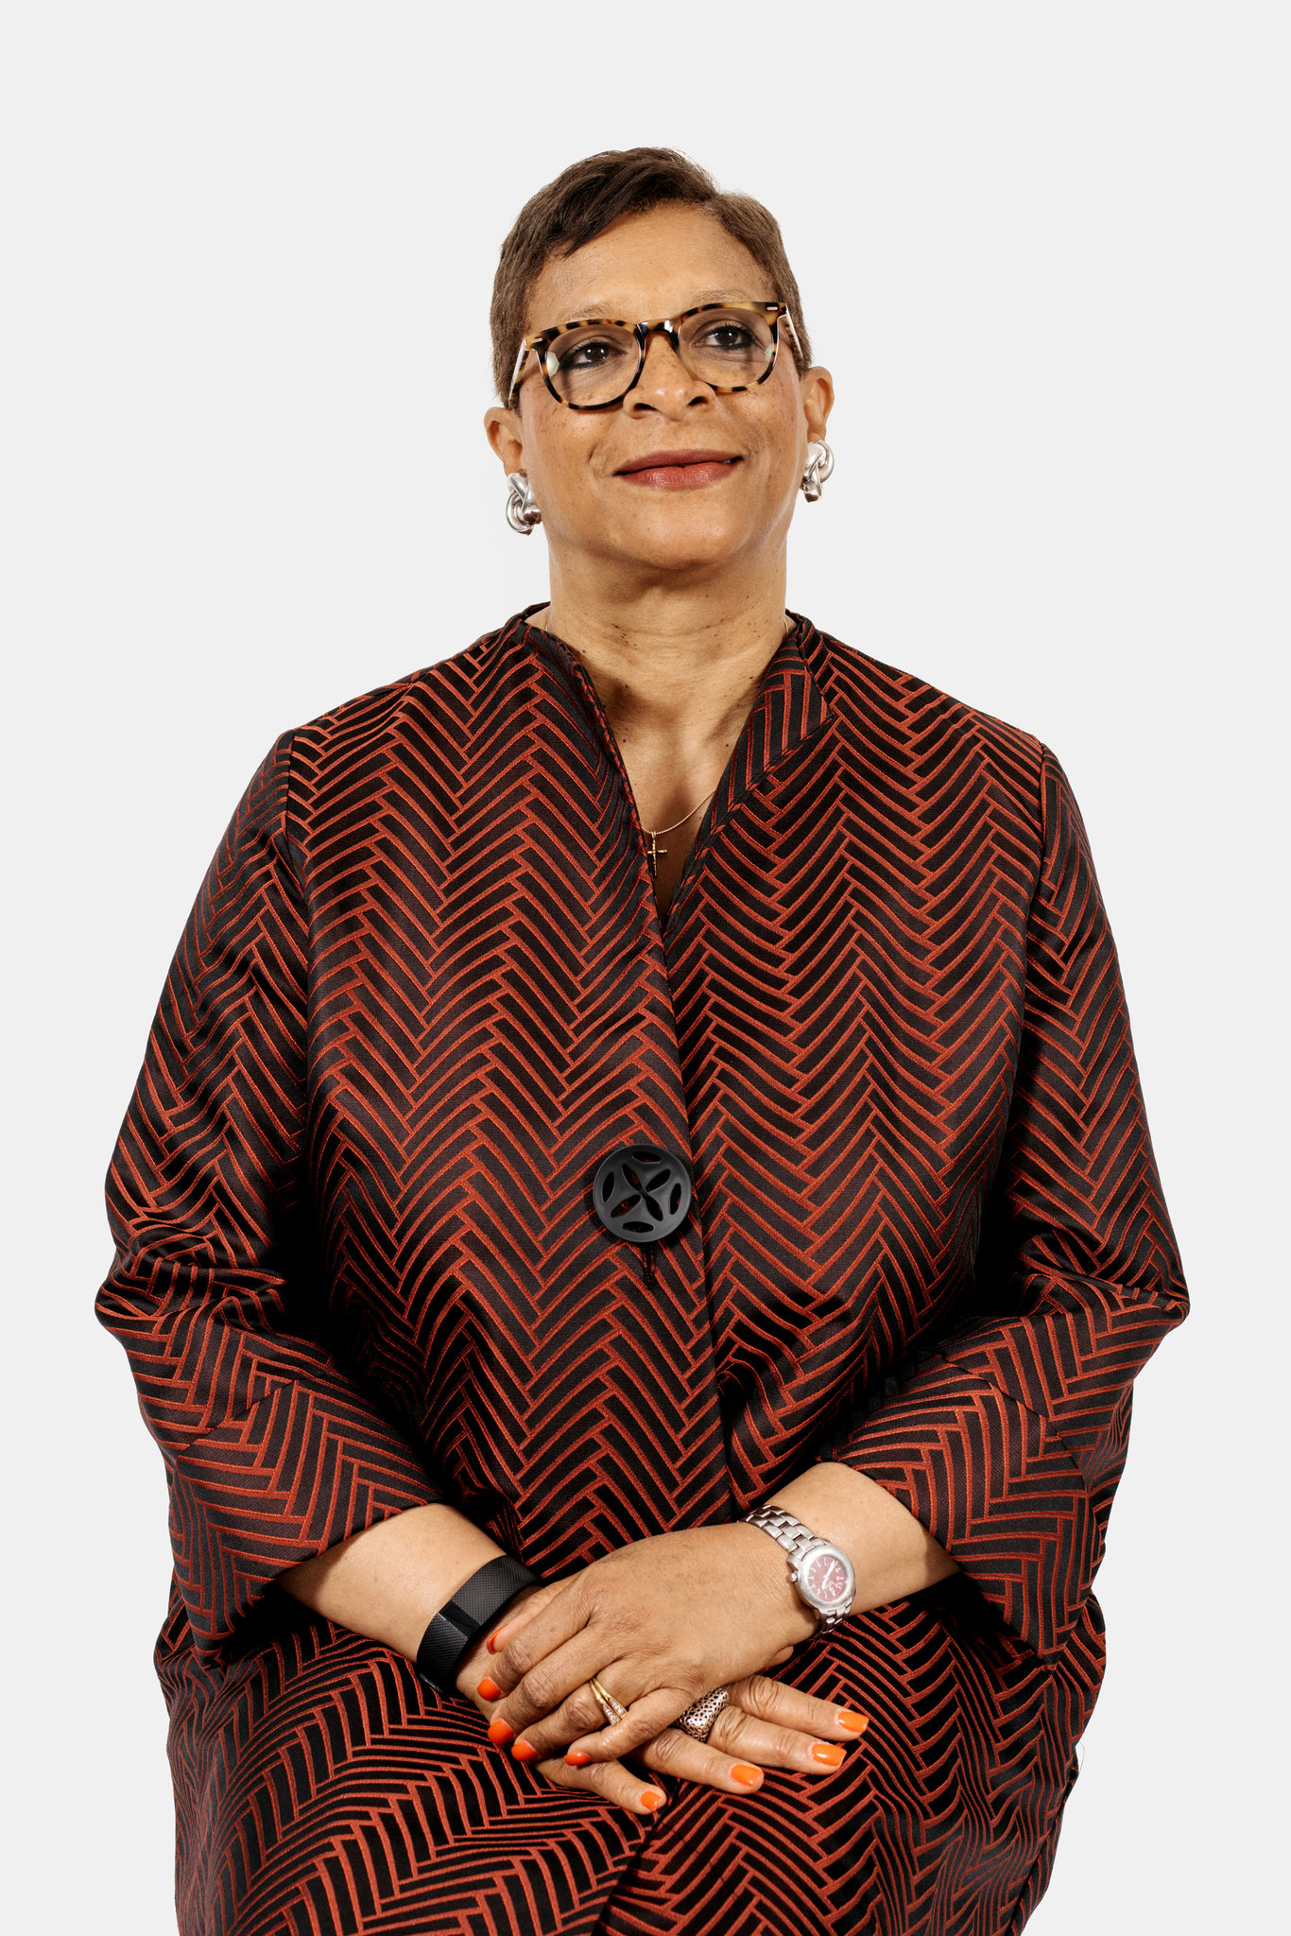
Sandra Sims-Williams
Chief diversity officer at the Publicis Groupe
“We can sit in rooms and talk to ourselves, but that does not change anything when you do not have men in the room.”

Slide 7
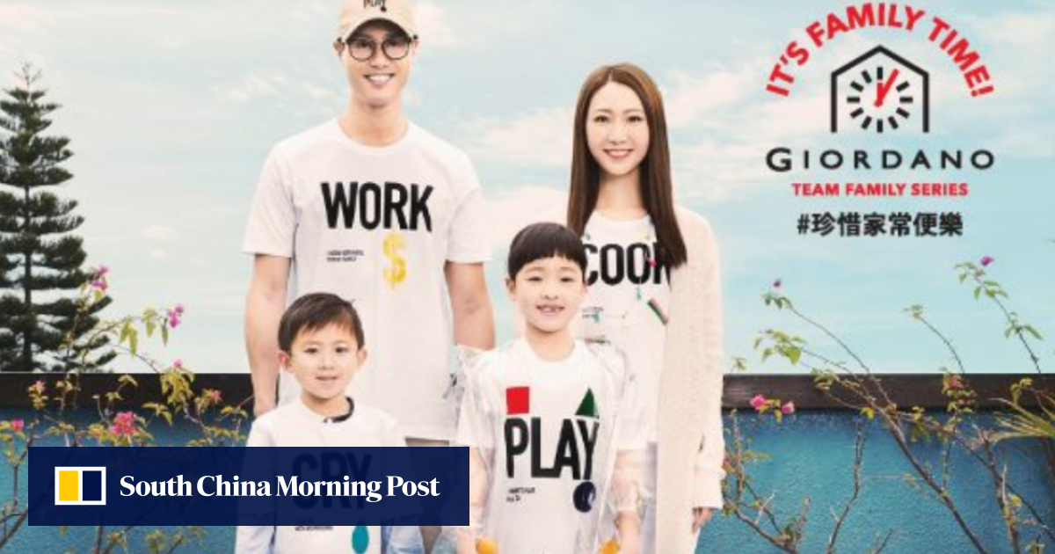
Gender issues in advertising
Sexists advertisements for various products.
The portrayal of gender roles via various adverts.
Household hierarchy being featured in adverts.
The remuneration of advertisers is influenced by gender.
Notes:
Several gender issues have been raised in recent times. There is an increase in oversexualizing women to increase the sale of a product through advertising. Adverts involving are made explicit compared to those men. The gender roles have also been portrayed differently in adverts as most of the adverts use women playing characters of household chores while men appeared in the electronics or other technical adverts. The household hierarchy has been evident through the various adverts where the man is portrayed as the head of the family and the women or wife as the subject. The remuneration of advertisers depends on the gender of the individual, where men are highly renumerated compared to women.

Slide 8
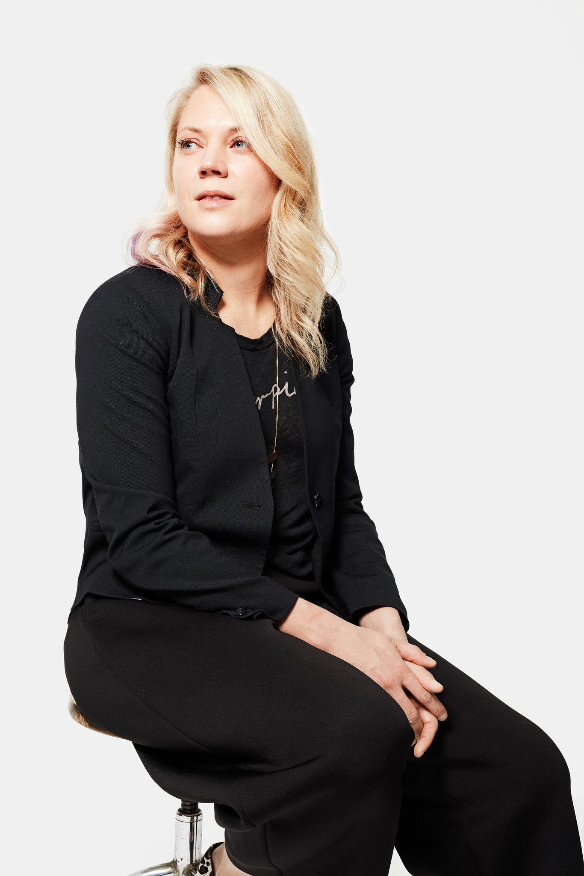
Erin Matts
Chief executive of Annalect North America
“I don’t see any truly malicious behavior. I see more of accidentally insensitive behavior.”

Slide 9
Oppression and violence against women through adverts
Adverts that portray women as subjects to men exposes to oppression.
Advertising based on gender roles is stereotyping (Zotos et al, 2018).
The appearance of women on household chores is discriminative.
Oppression is advanced through uneven opportunities in advertising.
Notes:
This vice against women or the female gender has been fought through various programs such as women empowerment, and strides have been made. However, it has been promoted through advertising in a way that stereotypes one gender against the other. Oppression on women is promoted only in household chores while others appear in more prestigious duties. This kind of advertising is discriminatory. There is uneven remuneration or compensation for women in advertising compared to their male counterparts.

Slide 10
Is it because we are WOMEN ??
Women now make up almost 50 percent of those working in the advertising industry, including a relatively small number in top executive positions.
Nancy Hill, a longtime advertising executive who is now president and chief executive of the 4A’s, an industry trade group, said that men called her “young girl” all the time, though she has been working in the business for decades.
“They don’t recognize that’s demeaning,” she said
Some women also said gender discrimination showed up when looking at the ads that agencies produce. Many ads portray stereotypical gender roles, they said, with mothers in the kitchen, for instance, and men driving cars. Several women noted that only 11 percent of creative directors are women, a statistic from the 3% Conference, which supports female creative leadership at agencies

Slide 11
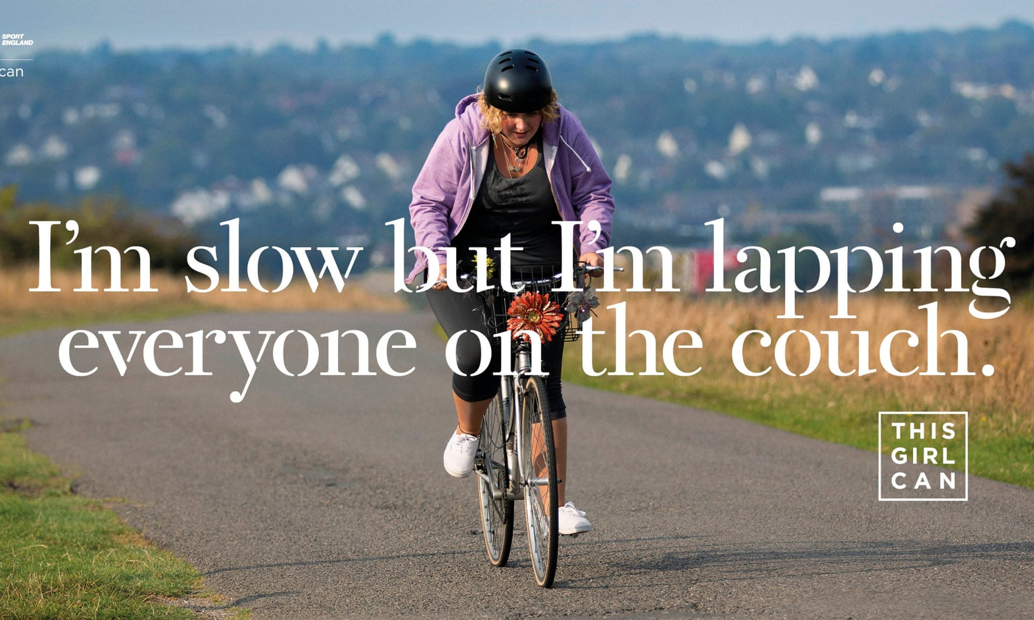
Promoting gender equity through advertising
Alternate of roles based on merit and not gender.
Creation of content that is against gender inequality.
Ensure ethical consideration in advertising (Zotos et al, 2018).
Create an equal platform for the advertisement industry.
Notes:
There are various ways that the adverts can promote a safe environment or conditions for the women in the society. The adverts can be done to call out practices such as stereotyping against women or any other gender. There should be alternating roles or appearances based on merit and not the gender of the participants. There should be ethical considerations for the advertisements to ensure that adverts are sensitive to gender issues. The advertisement industry should be favorable for all genders to thrive in.

Slide 12
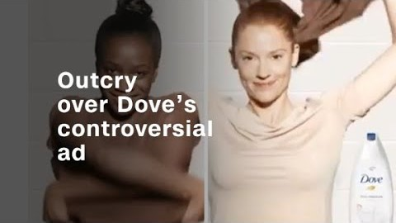
It is bad enough we are not respected as women; can you imagine being a Black Woman?

Slide 13

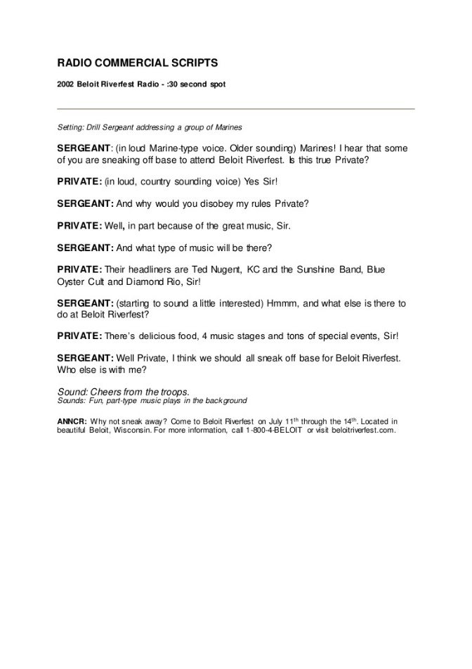
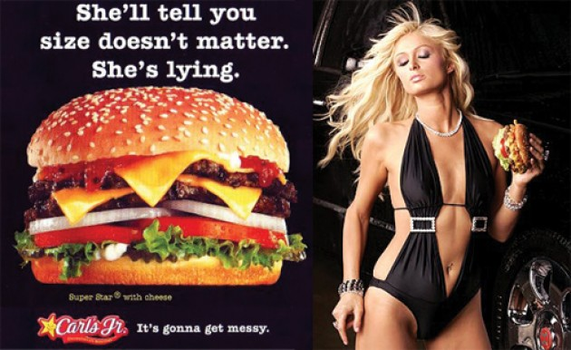
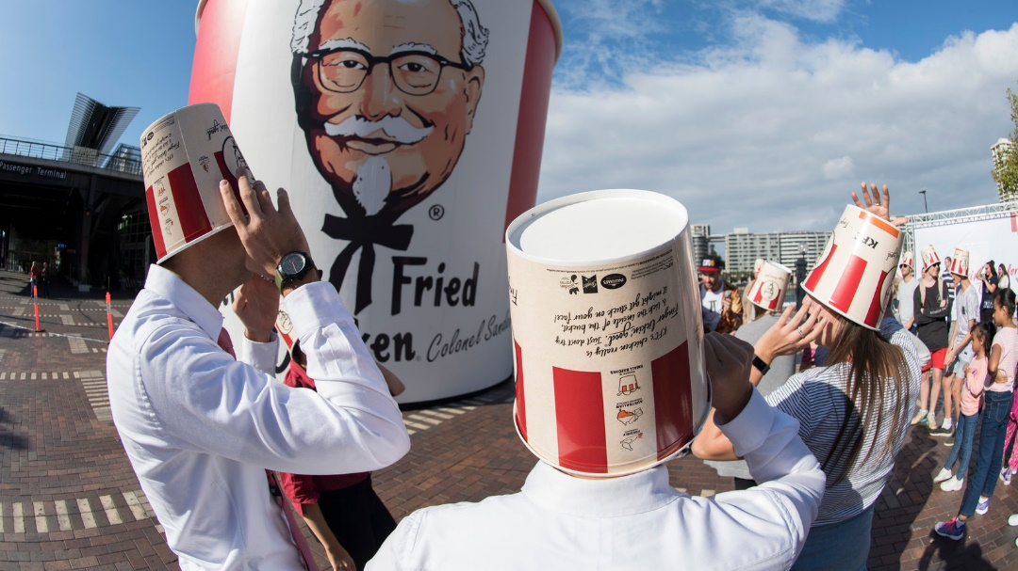
Examples of controversial ads

Slide 14
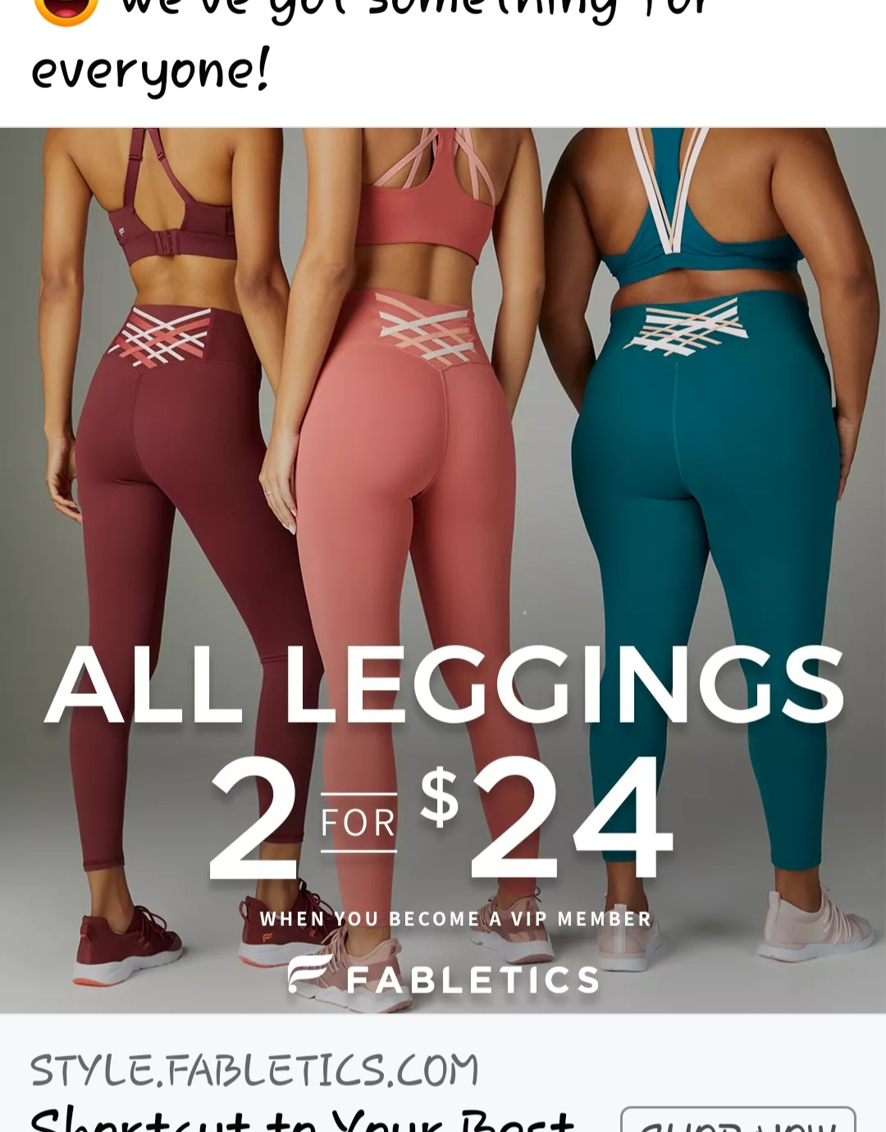
Fabletics
Notes:
This Fabletics ad insinuates a few things. First of all, the ad insinuates that all women want or need their "best butt." Using the ever so popular "peach"emoji to represent the "best butt" further shows the sexism that exists in this ad. Would be dare see an ad geared towards men that encouraged them to buy a product so that they could work on showing off their best butt? That being said, not all women who wear leggings are wearing leggings to gain attention or to show off their butt. Some women wear leggings for the simple reason that they are comfortable. The caption of "something for everyone" and the pictures of the backsides of various sized women also points out the size difference in the women.

Slide 15
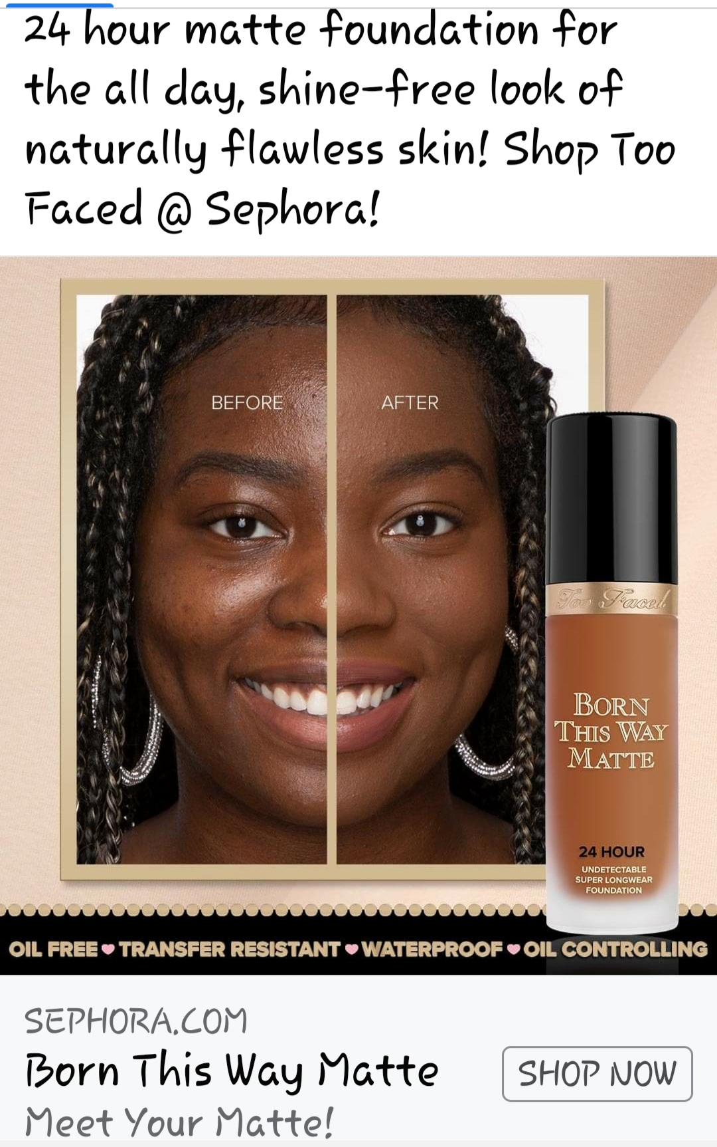
Too Faced
Notes:
This ad by Too Faced highlights their "Born this Way Matte" foundation. This ad insinuates that women strive for a shine free look and that there is something wrong with shine and skin imperfections. It is very presumptuous of Too Faced to assume that women want or need to cover up skin imperfections.

Slide 16
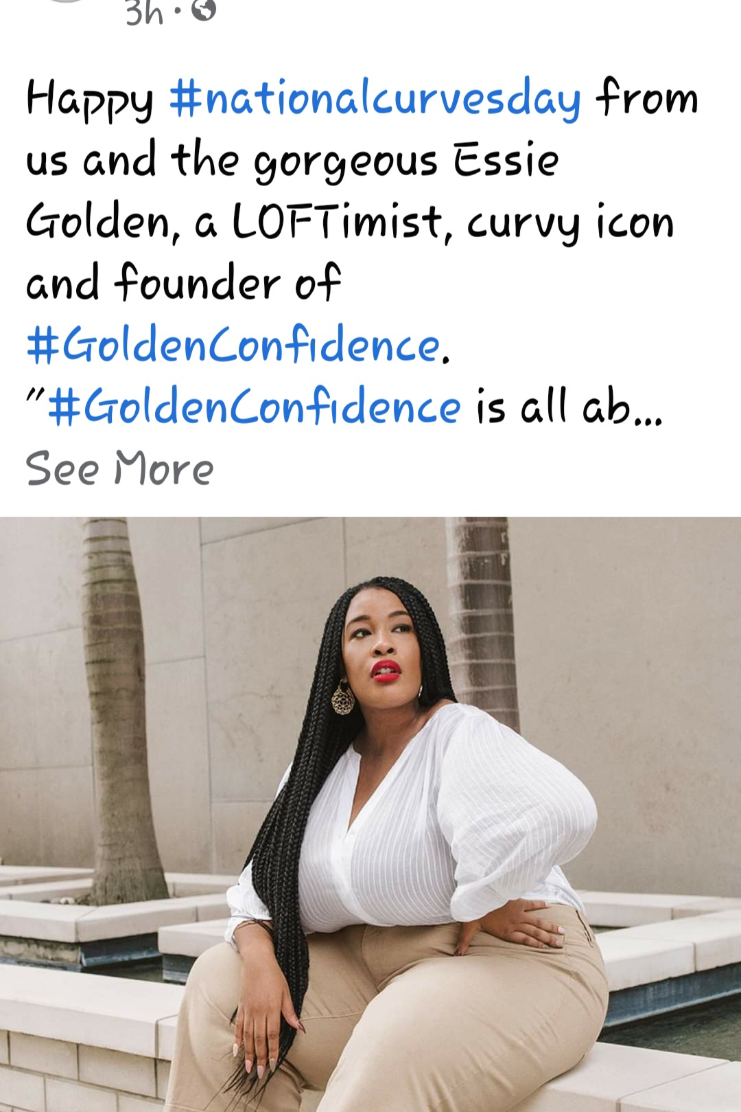
Loft
Notes:
This ad by Loft is highlighting National Curves Day. First of all, the fact that we have to have a day to celebrate curves is a bit concerning. Would Loft promote a day celebrating skinny women? I think it is great that Essie Golden, the founder of Golden Confidence is high lighted in an ad showing of her confidence but I question the appropriateness of having a National Curves Day.

Slide 17
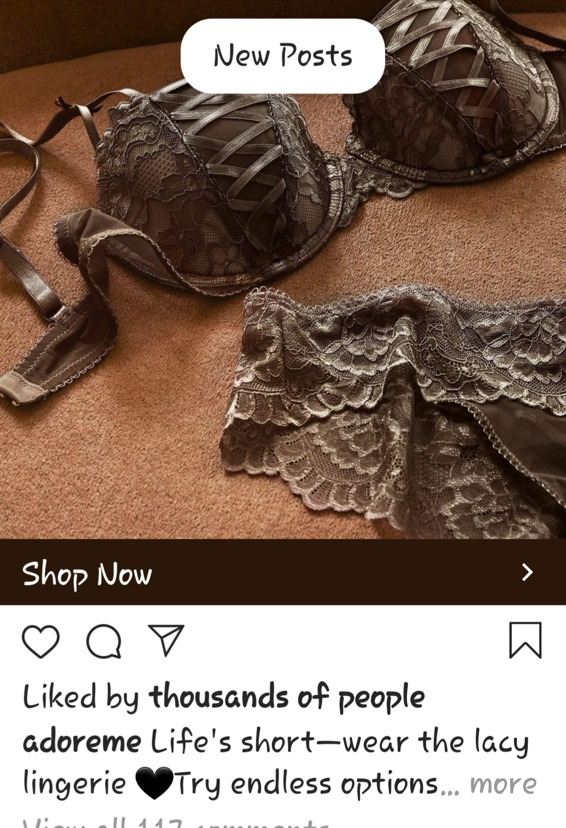
Adore Me
Notes:
This ad by Adore Me shows lacy lingerie with the insinuation that a woman must wear matching lingerie in order to be sexy. This ad is totally geared at women to make them feel this is how they need to dress to seduce and/or impress a man- which is really not true!

Slide 18

CupShe
Notes:
This CupShe ad is interesting to me for one reason. While I find it to be tasteful, I find it ironic that they use the words "Stayin classy" and have the model in a one piece suit. Does a more modest suit equate to classy? Would CupShe post an ad with a woman wearing a thong bikini and use the words "classy?
"

Slide 19
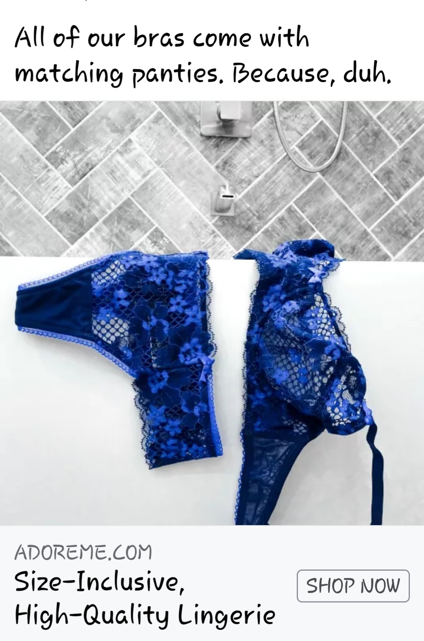
Adore Me
Notes:
Here is another ad by Adore Me that indicates that women need to wear matching bra and panties to be sexy. Also, the placement of the bra and panties over the side of the tub ads an extra layer of "sexy" to the ad. The ad also includes that Adore Me is size inclusive, showing that women of all sizes can shop there. I think it is insensitive to add that as it insinuates that unless it is noted, larger women may not think their sizes would be available.

Slide 20
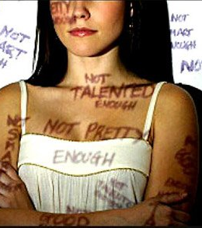
Oppression of Women in Social Media
“This reticence of women in Social Media is largely a result of the unfavorable, and even often abusive, responses they get purely on the basis of their gender (Ramasubbu, 2017)”.
“Pornography, e-mail harassment, “flaming” (abusive or obscene language), and cyber-stalking are some of the issues faced by women in social media (Ramasubbu, 2017)”.
Notes:
Most people experience some form of cyberbullying at some point in time. Being online provides a mask for people to use, they can essentially say whatever they like without having to see the person face to face. Women experience very negative comments on social media no matter what they post. They typically receive comments based on what they are wearing and how they look. People in general are so critical of each other, but women are subject to more discrimination and harassment on social media.

Slide 21
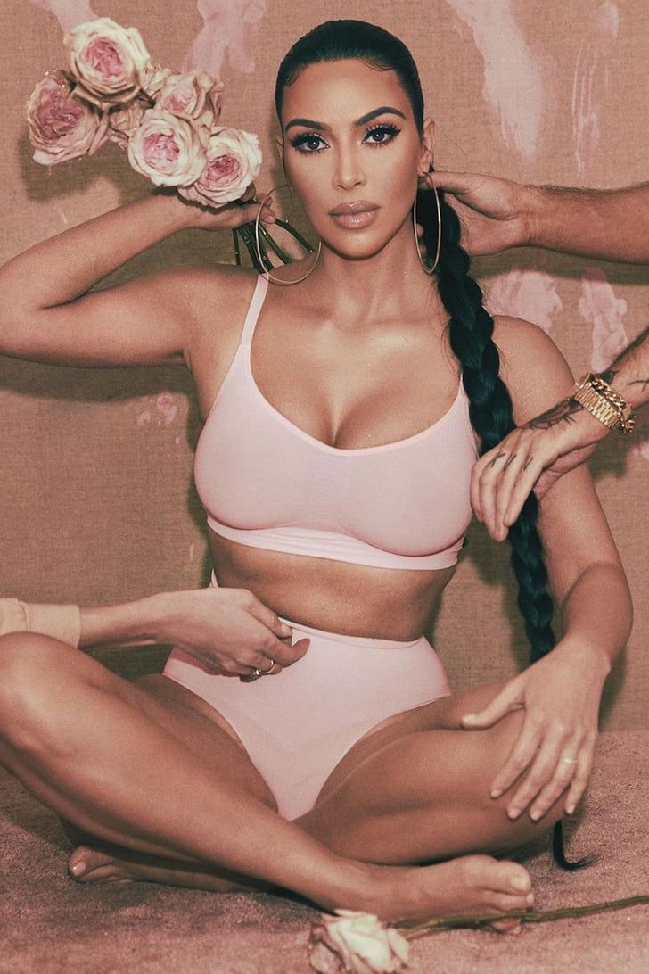
Social Media and Gender Stereotyping
Commercials that appear in social networking sites, can be a source of gender stereotyping (Ramasubbu, 2017).
“Women are more often presented in commercials involving cosmetic and domestic products while ads for men focus on cars, business products or investments (Ramasubbu, 2017)”.
Many ads show entire figures of women and close-up shots for men, objectifying the female body (Ramasubbu, 2017).
Notes:
The types of ads shown on social media sites further gender stereotyping in our society. Many ads done by women are for clothing, make up, etc. while men mainly are portrayed in ads for economic or business purposes. Women are often highly sexualized, showing a lot of skin at times and wearing make up. Not only does this play into gender roles, it also creates a universal idea of beauty that many women feel the need to live up to.

Slide 22

Adolescent Girls in Social Media
“Adolescent girls are also more likely to share personal information than boys, thus exposing themselves to possible sexual predation or cyber bullying” (Thompson, 2018).
“Adolescent girls and boys differ in the types of content they post to their profiles; girls reportedly post “cute” pictures, either of themselves or random, while boys were more likely to share pictures and comments that they described as self-promoting and often containing sexual content or references to alcohol” (Thompson, 2018).
Notes:
As social media has become more popular over the past two decades there have been some noticeable changes in the youth of our society. There has been a surge in cyberbullying leading to an increase of various issues, including mental health. Young girls often times have unlimited access to social media and can view models and celebrities' daily lives. Young minds are impressionable as it is so to constantly be seeing images of how women are supposed to look and behave can have such a negative effect.

Slide 23
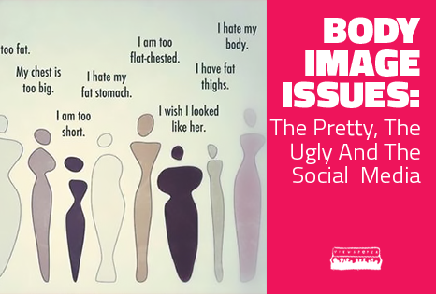
Social Media and Body Image
"Social media has become a way to put these false images right in your field of vision whether you opt for them or not," Mramor said.
“Women are less likely to be happy with their bodies if they spend more than an hour a day on social media, the findings showed (Thompson, 2018)”.
The feedback women receive on social media could be making them insecure, particularly if they fail to realize that "what people post is nearly always images of themselves in a positive light," Graff said.
Notes:
The emergence of social media has created a lot of positive and negative effects on women. When women are constantly looking at images of other women there are consequences, if only subconsciously. Women will compare themselves to the images that they see on social media, sometimes not realizing that the images people post may be edited or altered. Also, people in general post the best parts of their lives on social media. Not many people post the bad and the ugly. Therefore, women are comparing their bodies to usually edited, unrealistic images of other women.

Slide 24
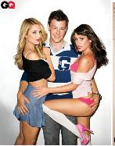
Exploitation of Women in Social Media
“Over the last 25 years, big clothing and cosmetic brands have started targeting young girls. Advertisements show them wearing highly provocative dresses, make-up, and often in age-inappropriate, hypersexualized postures and body language” (Sen et al, 2020).
Women feel their appearance is a measure of the amount of love and the power they receive. As a result, It puts tremendous pressure on them to conform to conventional beauty standards (Sen et al, 2020).
“According to UNICEF, ‘The objectification and sexualization of girls in the media is linked to violence against women and girls worldwide’” (Sen et al, 2020).
Women are often portrayed as objects of pleasure. Boys and men tend to internalize that message, and it influences their subconscious biases of how they view women (Sen et al, 2020).
Notes:
Social media advertising has a lot more negative effects than positive. Not only has it shown to have detrimental effects on women's mental health and body images, it has always perpetuated violence against women. As much as women use social media, men do too. Men are constantly seeing the same images which creates their own view of women and how to treat them. Negative behavior and negative action towards women is viewed as the normal. The cycle repeats itself and the treatment of women does not improve.

Slide 25

Advertising in Film
Film advertising is a marketing strategy which results into a large viewing.
Advertising is used to promote a film to its intended audience and beyond.
It is essential as making of the film
It is done to ensure the movie is a ‘must see’ film
Different advertising strategies: posters, interviews,
billboards and magazine interviews.

Slide 26

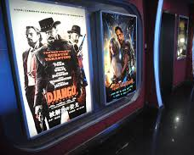
Posters
All films have posters which are placed everywhere to accompany the film trailer.
On bus stops, cinemas, streets, poles and buses.
Designed to capture the attention of the people.
To make people want to find out about the film.
Done in the style of the film (Wang & Lee, 2019).
Include a tagline, title, starring and the actors.

Slide 27
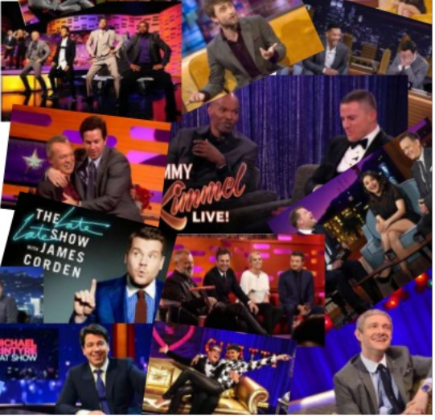
TV Interviews
Booking talk shows for the actors to go market the movie.
The stars go on shows with audiences to market the film.
Doing this gets the movie out to the wider audience.
It makes the movie well known before it comes out officially(Paul, 2015).

Slide 28

Billboards
Billboards are used to get the film to the general population.
Are placed in places with a lot of traffic
Thus, they are seen by many people as possible.
The film gets a lot of exposure.
They are attractive and eye catching.
They get the message in a matter of seconds (Wong, 2020).

Slide 29
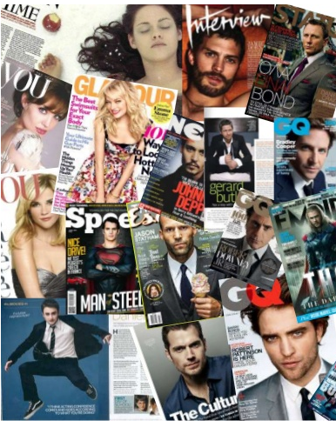
Magazine Interviews
They are done when the film is near releasing.
They are done to promote and market the film.
Tactic is used to get film to bigger audience.
Offers audience personal interaction with actors.
They address behind the scenes thus giving insight into the movie.

Slide 30
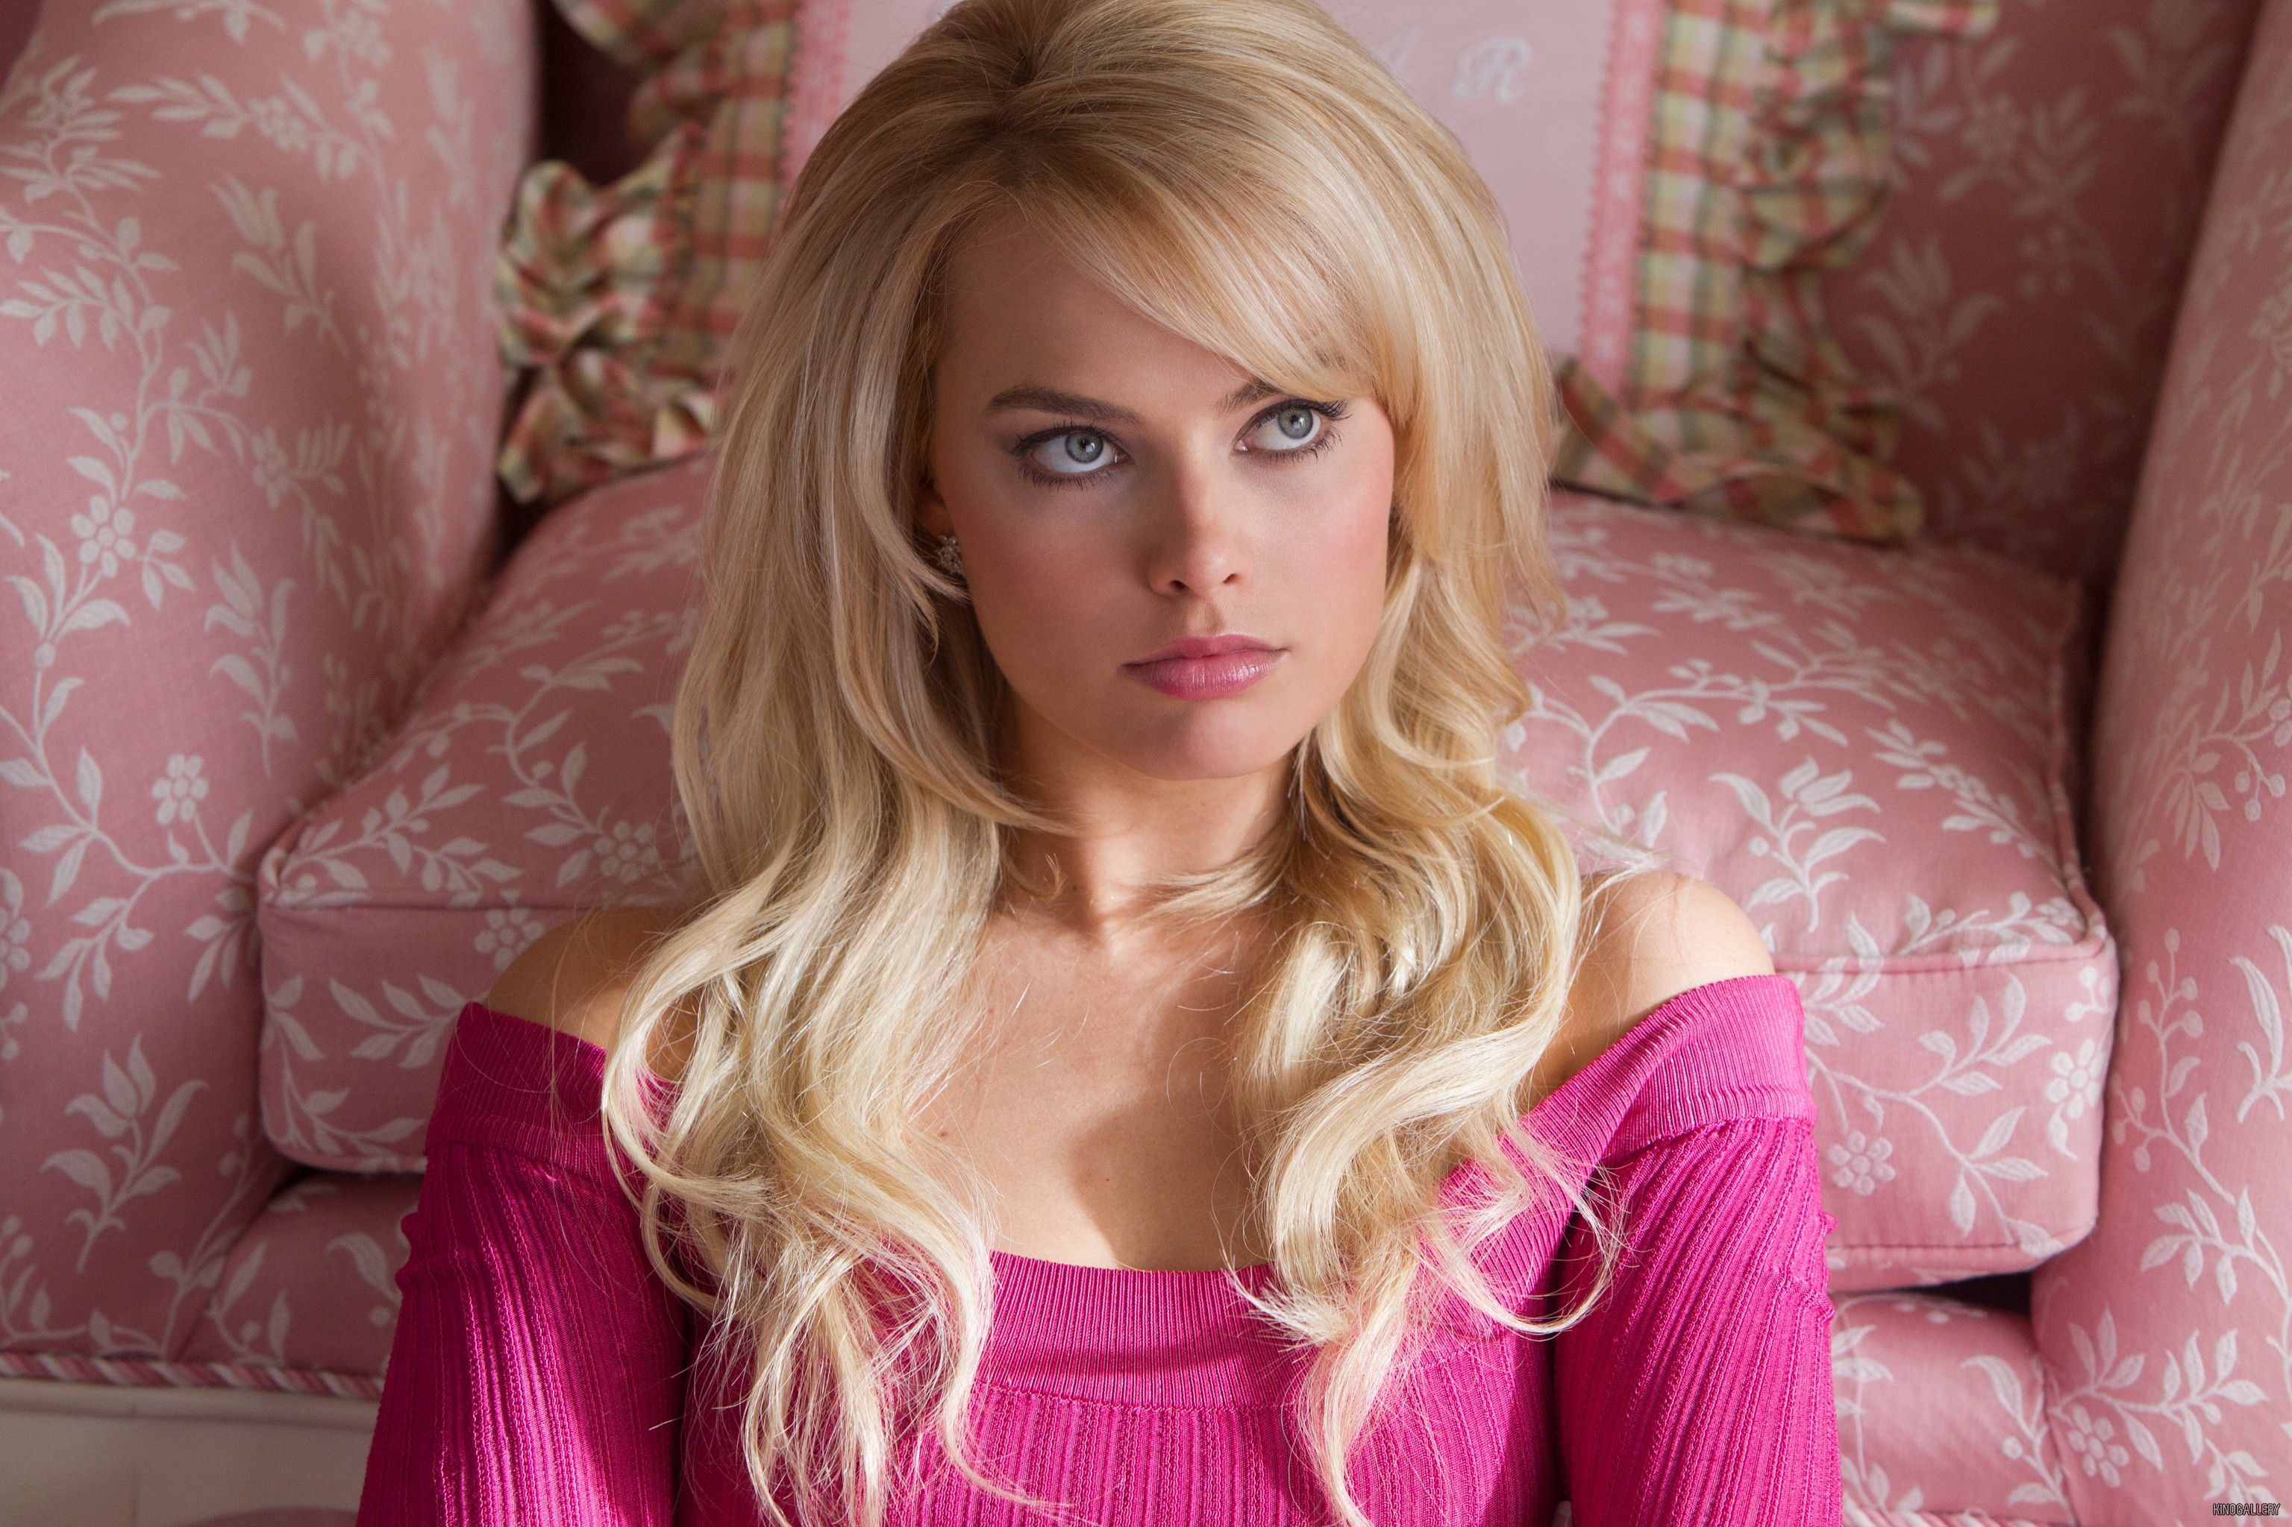
Perception of woman in film
“Nowadays, women must have it all, especially the ones on the silver screen – the ones teaching the rest of us what we should aspire to become.” – Kyla McDowall
Woman are viewed in a lot of films, especially romantic or action movies, to have the perfect body or always pedicured to have no imperfections.
While also being the submissive partner to the man.

Slide 31
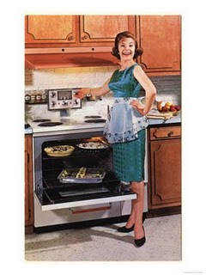
The role women played in the past
“In the past, some actresses had a measure of power or at least staying power in Hollywood, but too many more were typecast as bratty sisters, dutiful daughters or sexpots, and then cast aside. And some of their most memorable characters were, like their adult counterparts, defined by hypersexuality or asexuality.”
Woman have always gotten the back hand of getting respect in Hollywood because of the objectifying roles that have been placed upon them. Like the stereotypical housewife or dependent on the man.

Slide 32
The role women play now
“Characters like Katniss Everdeen are changing girlhood and challenging tired stereotypes by not waiting for some guy to save the day: They’re saving themselves and their worlds, too. Yet Katniss, her screen sisters and the industry have a very long way to go.”
Woman in films now are starting to develop into characters that are independent and don’t follow the norms of society of how gender would get in their way. They show just how strong and resilient their demeaner can be.

Slide 33
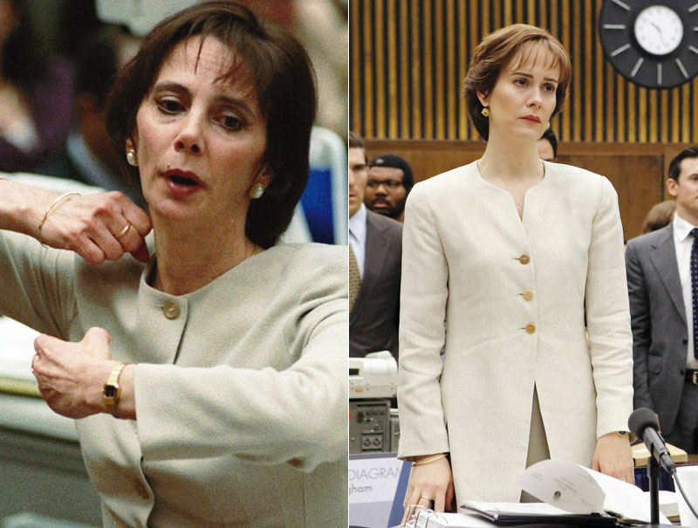
The roles continued
Roles like Katniss Evergreen and Marica Clark envision bold sacrifices that woman are trying to uphold.
In the show OJ vs the people Sarah Paulson made it apparent to play Marcia Clark in the best way possible to uphold her amazing reputation and groundbreaking moment for women in history.
“I know how much Marcia is identifiable, both in image and sound, because so many of us watched it,” she says. “There was such an awareness to what she represented in that time in our country’s history.”
“The drama explores the rampant sexism that Clark endured, the humiliation of going through a divorce, her custody battles with her soon-to-be-ex husband. At the dinner, Paulson says she wanted to stress to Clark that the production wasn’t going to drag her name through the mud.”
Actresses like Sarah Paulson have shown great strides woman are taking over the main character positions.

Slide 34
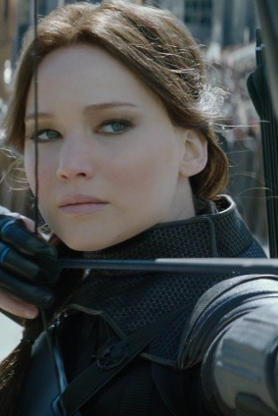
The toll of roles in society
“The picture of girlhood at the movies has become an increasingly diverse, sometimes contradictory array of identities, including bold revisions of age-old archetypes and brave new heroines. That said, the faces of these girls remain exasperatingly monochromatic.”
With the new ways of the world of feminism getting respect and taken seriously it is allowing young girls to envision lifestyles for themselves that allow them to hold power and not just the typical housewife role.
“Characters like Katniss Everdeen are changing girlhood and challenging tired stereotypes by not waiting for some guy to save the day: They’re saving themselves and their worlds, too. Yet Katniss, her screen sisters and the industry have a very long way to go. ”

Slide 35

Work still ahead
Even though with the increasing woman lead star roles, there are still the notions of the old stereotypes that still in Hollywood society sees.
“In one study the Geena Davis Institute on Gender in Media looked at 5,554 “distinct speaking characters” in 122 family movies rated G, PG or PG-13 that were released between 2006 and 2009. The institute discovered that only 29.2 percent of those roles were female, while a whopping 70.8 percent were male. In other words, there were 2.42 male characters for every female one. Put another way, there was Harry and Ron and then there was Hermione, the smartest girl in the class. Hermione ruled, but not nearly enough.”
Woman still have to fight for the presence of being seen and heard in society to be taken seriously and it is up to creators to dimmish or cut back the roles that put this view on woman

Slide 36
References
Birnbaum, Debra. “Sarah Paulson on Taking on the Role of Her Life in 'The People v. O.J. Simpson'.” Variety, Variety, 27 Jan. 2016, variety.com/2016/tv/features/sarah-paulson-people-v-oj-simpson-marcia-clark-1201689199/.
By, and Kyla McDowall. “The Issue of the Portrayal of Women in Film and Media.” Glasgow Women's Library, 1 July 2016, womenslibrary.org.uk/2016/06/30/the-issue-of-the-portrayal-of-women-in-film-and-media/.
Nixon, S. (2003). Advertising cultures: gender, commerce, creativity. Sage.
Paul. J.(2015).How to Market Your Film on a Small Budget. (2015). Retrieved 25 October 2020, from https://www.premiumbeat.com/blog/how-to-market-your-film-on-a-small-budget/
Ramasubbu, S. (2017, December 07). Does Gender Matter on Social Media? Retrieved October 23, 2020, from https://www.huffpost.com/entry/does-gender-matter-on-soc_b_7591920
Scott, A. O., and Manohla Dargis. “Sugar, Spice and Guts.” The New York Times, The New York Times, 3 Sept. 2014, www.nytimes.com/2014/09/07/movies/fall-arts-preview-representation-of-female-characters-in-movies-is-improving.html.
Sen, S. (2020, October 15). Objectification of women by the mass media. Retrieved October 23, 2020, from https://www.rightsofequality.com/objectification-and-exploitation-of-girls-and-women-by-the-mass-media-and-the-social-media/
Thompson, D. (2018, May 04). Social Media May Harm a Woman's Body Image. Retrieved October 23, 2020, from https://www.webmd.com/women/news/20180504/too-much-social-media-may-harm-a-womans-body-image
Wang, S., & Lee, T. H. (2019). Study of films marketing made from original games. Journal of Digital Convergence, 17(10), 417-426.
Wong, K. (2020). Harnessing Hollywood hype: Film marketing meets the challenges and opportunities of the 21st century. Retrieved 25 October 2020, from https://repository.upenn.edu/dissertations/AAI10003886/
Zotos, Y., Grau, S., & Taylor, C. R. (Eds.). (2018). Current Research on Gender Issues in Advertising. Routledge.

